Slide 1
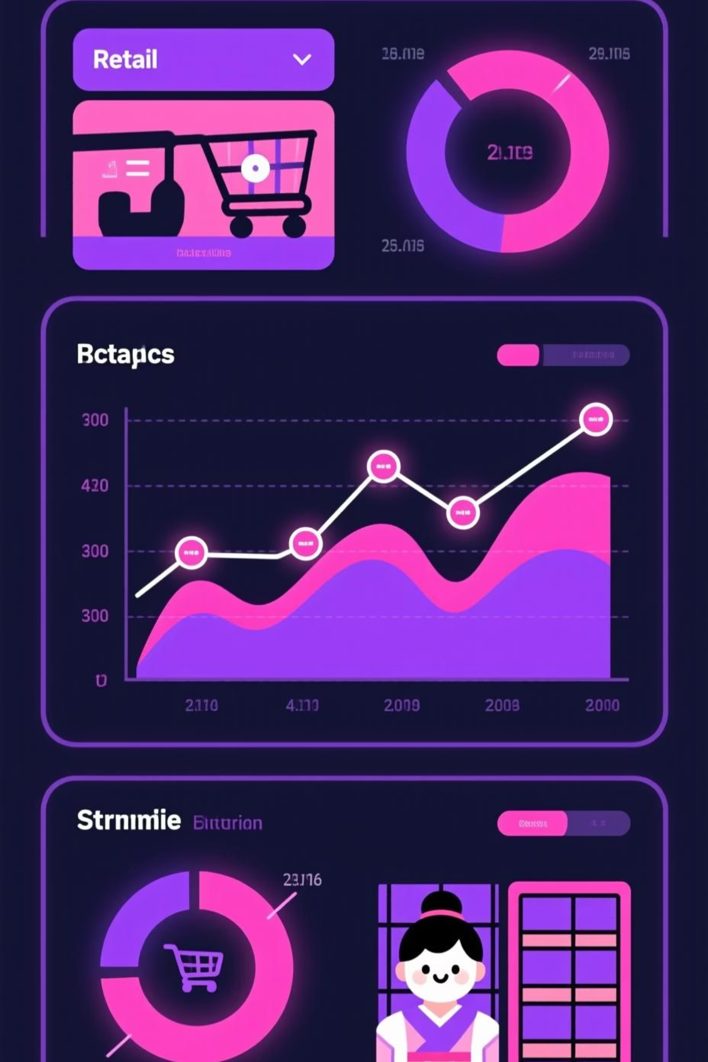
Customer Shopping Behavior Analysis
Uncovering insights from 3,900 purchases to guide strategic business decisions

Slide 2

Project Scope
Dataset Size
Data Points
3,900 transactions analyzed
18 key features tracked
Focus Areas
Spending patterns, segments, preferences

Slide 3

Key Data Features
Customer Profile
Purchase Details
Shopping Behavior
Age & Gender
Item & Category
Discount Applied
Location
Amount & Season
Promo Code Used
Subscription Status
Size & Color
Review Rating

Slide 4




Data Preparation Journey
Data Loading
Imported dataset using pandas
Verification
Validated data integrity
Cleaning
Removed 37 null values

Slide 5
Python Analysis Process
01
02
df.describe()
include='all'
Aggregate functions on numeric columns
Display all columns from source
03
04
df.isnull().sum()
Null Removal
Identified null values in data
Cleaned dataset for analysis

Slide 6

Database Integration
PostgreSQL Setup
Data Loading
Query Ready
Created database structure for customer shopping data
Successfully imported cleaned dataset into database
Prepared comprehensive question list for analysis

Slide 7

Power BI Dashboard
Transformed data into compelling visual insights for strategic decision-making

Slide 8
Complete Project Roadmap
CSV Source
Database Loading
Raw transaction data
PostgreSQL integration
1
2
3
4
Data Cleansing
Power BI
Jupyter Notebooks & pandas
Visualization & reporting

Slide 9


Technical Stack
Python & Pandas
Data cleaning and preparation
PostgreSQL
Robust data storage
Power BI
Interactive visualizations

Slide 10

Project Complete
End-to-end analysis pipeline delivering actionable insights from customer shopping behavior

